Slide 1
Sprint #4 Presentation
Jamil Khan, Chaz Del Prato, Benjamin Seo, Christine Duong, Brandon Le, John Him

Slide 2
Business Requirement Document
There are no updates to the BRD.

Slide 3
Updates
Management Plan
Gantt Chart
Burndown Chart
Project Tracking Matrix
Team Code Velocity
Sprint Retrospective

Slide 4
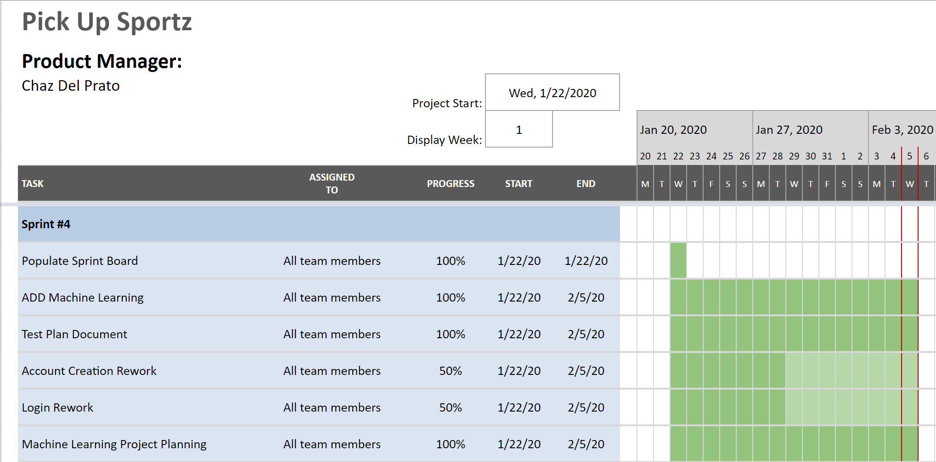
Gantt Chart

Slide 5
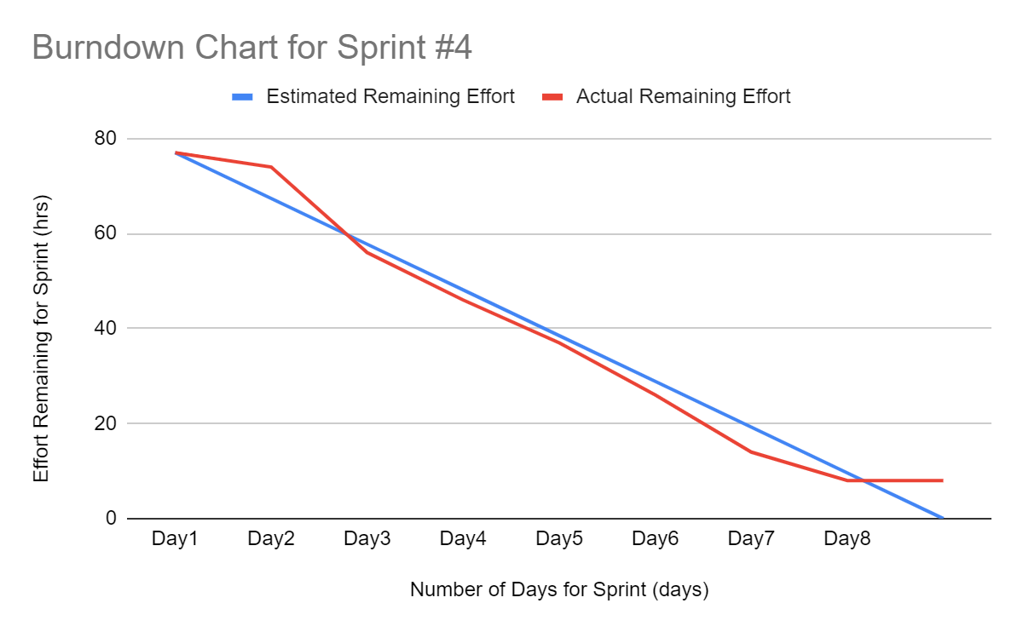
Burndown Curve

Slide 6
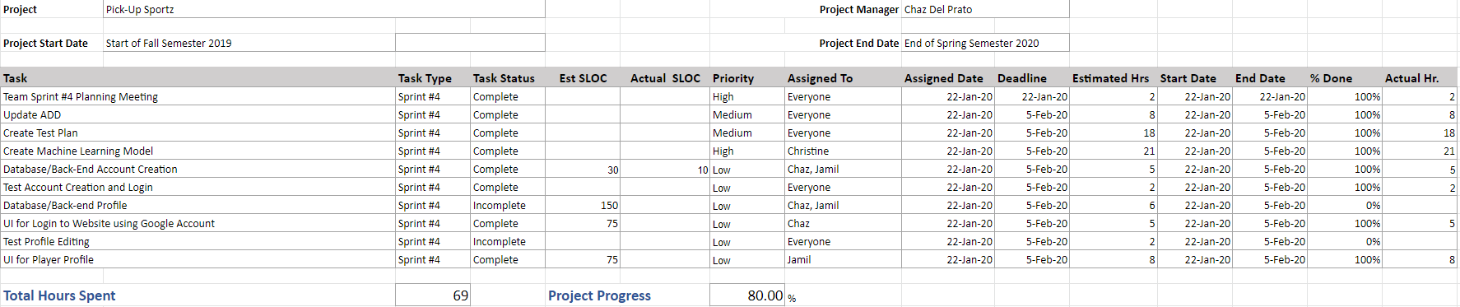
Project Planning Matrix

Slide 7
User Stories for This Sprint
Management Team:
As a member of the management team, I want a detailed plan of how machine learning is going to implemented, so that we can execute our model effectively and correctly.
As a member of the management team, I want to have a test plan, so that we can test the functionality of our product
As a member of the management team, I want all of our documents to be revised and up to date, so that we ace proceed with our next sprints

Slide 8
User Stories for This Sprint
Player:
As a player, I want to be able to edit a profile that shows my age, skill level, and interested sports, so that I get notified when a related game is started.
As a player, I want to be able to create an account and log in, so that I can use to product to the fullest potential.

Slide 9
Sprint Goals
Database/Back-End Profile Editing
Test Account Creation and Login
Database/Back-End Account Creation
UI for Login to Website using Google Account
UI for Player Profile
Test Profile Editing
Create Test Plan
Update Architecture and Design Document with Required Sections for Machine Learning
Create, Test, and Implement Machine Learning Model into Web Application

Slide 10
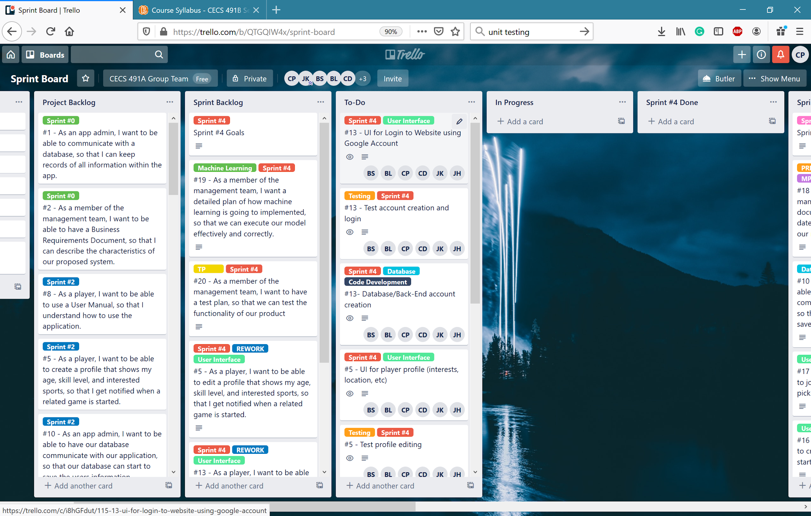
Sprint Board (Start)

Slide 11
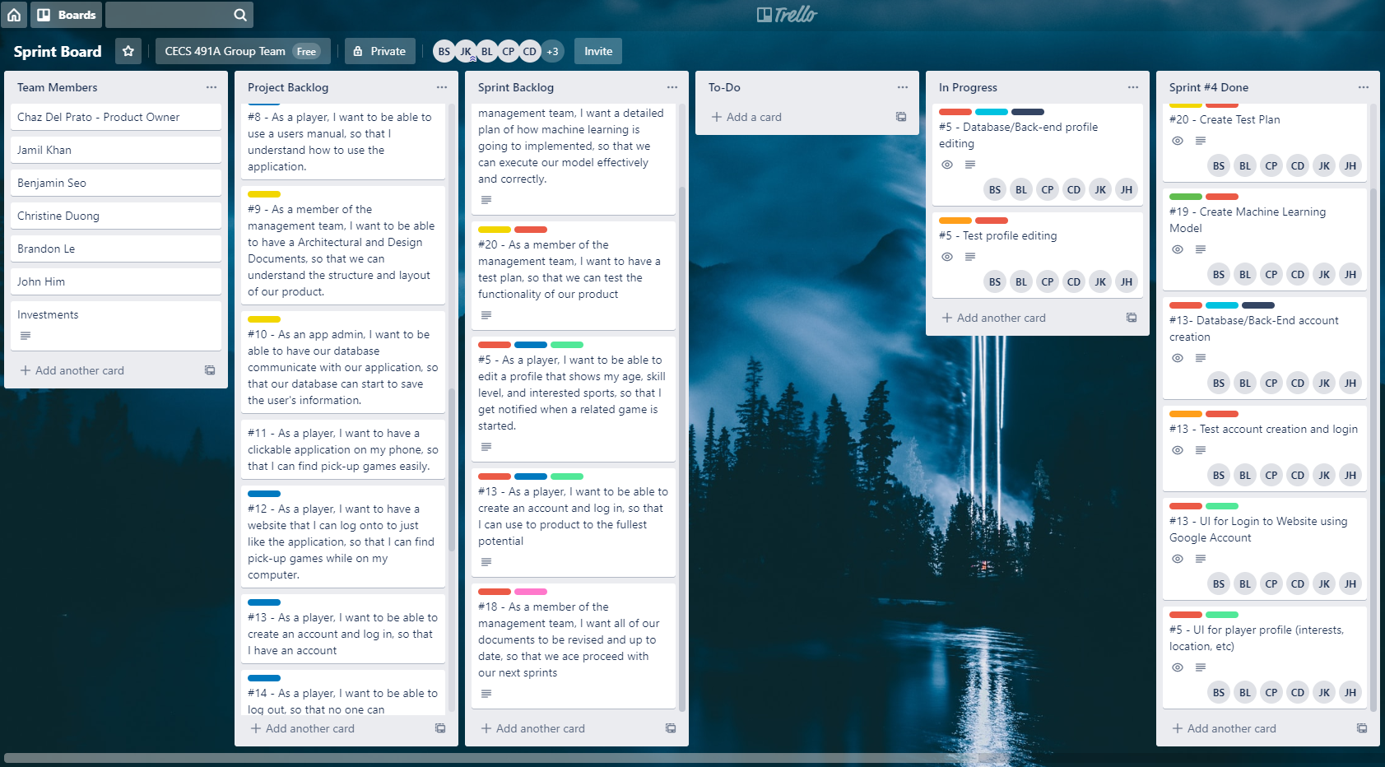
Sprint Board (End)

Slide 12
ADD Machine Learning Required Sections
How many APIs and servers are there?
Currently have a start to our own API
We using Firebase Hosting, so we are serverless at this point

Slide 13
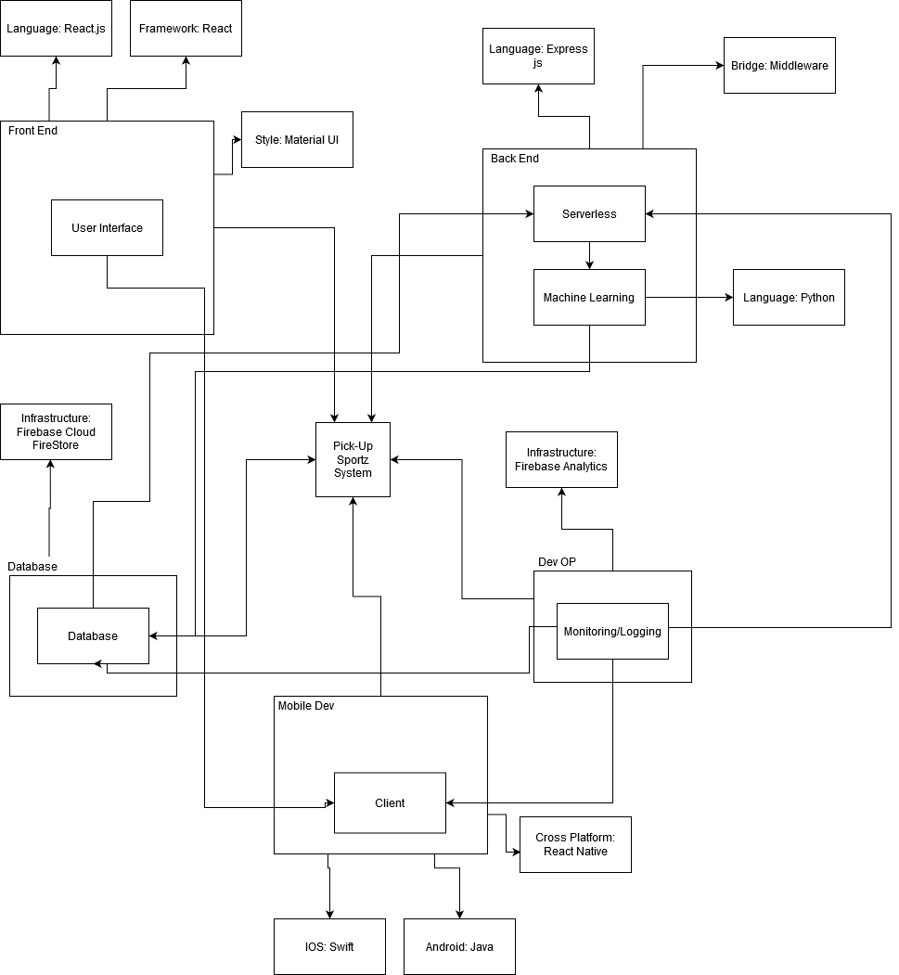
Briefly describe the architecture including the major components and interactions among the major components.

Slide 14
Test Plan
1. Test philosophy
a) Could you test everything you can think of? What criteria are you using to select what gets tested?
Yes we could test everything we can think of. The criteria we are using to select what gets tested is based on the user’s perspectives of their activities
b) Are there different densities of testing across your code? Will less well understood code go through more testing? Is there a code that does not require testing?
There are different densities of testing across our code. For example, we would test heavily on the primary functions like joining/creating an event and the machine learning component. We would focus less on more simple portions of the applications such as logging in/out, create account, modify settings, etc. For less understood codes, they will be tested more than simple codes but not as much compared to codes for like machine learning.

Slide 15
Test Plan
c) Why would your selected testing program be sufficient? What criteria do you use for making that decision?
We believe that the selected testing program would be sufficient due to the coverage of priority. The testing will cover all of our components in our application but with different priorities. For example, main functions and components will be tested more than smaller functions like UI. These are part of the criteria that we use to make our decision. The criteria would be to test everything but through a priority-based system.

Slide 16
Project ML Planning
Previously, we planned to use Machine Learning to send pick up games that the user would most likely be interested in
We will now be using Machine Learning to recommend users different sports that they are most likely to try based on previous sport(s) that they have played
The project will now be using a supervised classification model

Slide 17
What type of Object Relational Model (ORM), Object Data Modeling (ODM) library or driver is used in the connection of database to the server?
JSData
JSData converts data from JavaScript Objects to formats used by MySQL, MongoDB, RethinkDB, Firebase, etc. and vice versa

Slide 18
Sprint Retrospective
We achieved 69 hours of our goal 77 hours
Database/Back-End is still in the works
Wait for back-end to be set up to test account creation and login
UI for Login to Website using Google Account and Player Profile completed
Started Test Plan
Architecture and Design Document has been updated to meet the Required Sections for Machine Learning
Machine Learning will now be used in a different way
Currently learning how to implement classification

